Slide 1
Process View
Dr. Huma Hayat Khan

Slide 2
Activity Diagram
Activity diagram is an important diagram in UML to describe dynamic aspects of the system.
Activity diagram is basically a flow chart to represent the flow from one activity to another activity. The activity can be described as an operation of the system.
So the control flow is drawn from one operation to another. This flow can be sequential, branched or concurrent. Activity diagrams deals with all type of flow control by using different elements like fork, join etc.

Slide 3
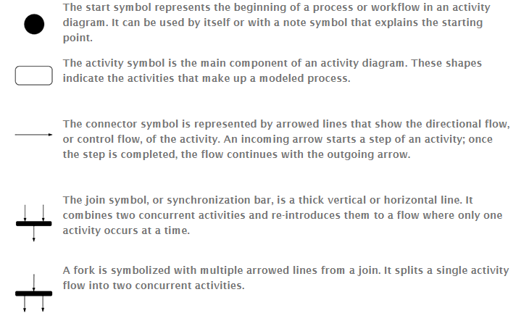


Slide 4
How to Draw an Activity Diagram
Before drawing an activity diagram we must have a clear understanding about the elements used in activity diagram.
The main element of an activity diagram is the activity itself.
An activity is a function performed by the system. After identifying the activities we need to understand how they are associated with constraints and conditions.

Slide 5
Cont…
So before drawing an activity diagram we should identify the following elements:
Activities
Association
Conditions
Constraints

Slide 6
Order management system (example)
In the diagram four activities are identified which are associated with conditions.
One important point should be clearly understood that an activity diagram cannot be exactly matched with the code.
The activity diagram is made to understand the flow of activities and mainly used by the business users.

Slide 7
Cont…
The diagram is drawn with the four main activities:
Send order by the customer
Receipt of the order
Confirm order
Dispatch order

Slide 8
Cont…
Description:
After receiving the order request condition checks are performed to check if it is normal or special order. After the type of order is identified dispatch activity is performed and that is marked as the termination of the process.

Slide 9
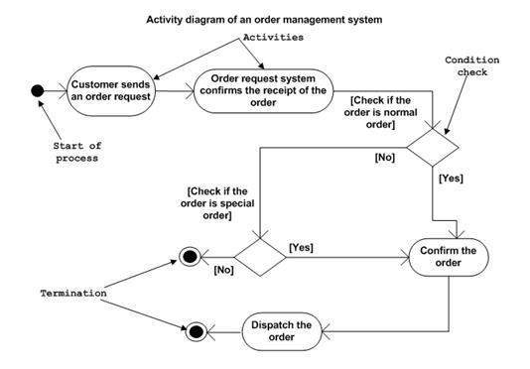

Slide 10
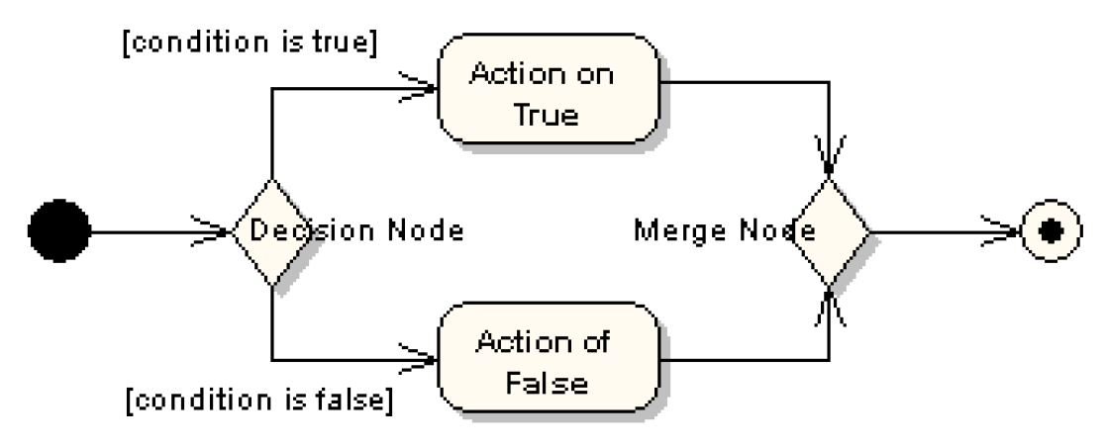
Decision and Merge Nodes
Decision nodes and merge nodes have the same notation: a diamond shape
The control flows coming away from a decision node will have guard conditions

Slide 11
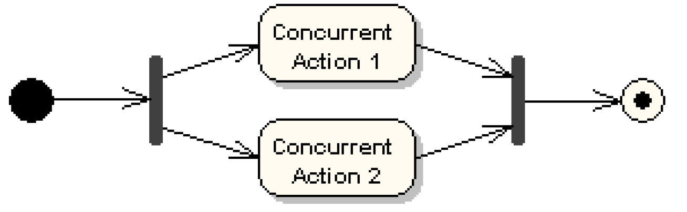
Fork and Join Nodes
Forks and joins have the same notation: either a horizontal or vertical bar
They indicate the start and end of concurrent threads of control
Join synchronizes two inflows and produces a single outflow
The outflow from a join cannot execute until all inflows have been received

Slide 12
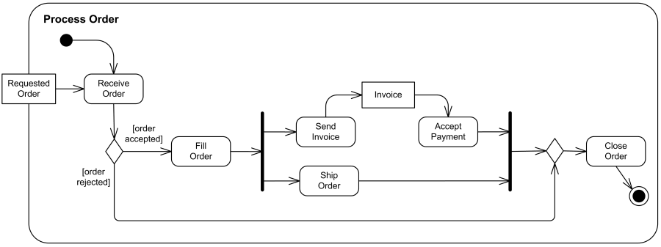
Process Order Example

